Slide 1
Chapter 5 Database Constraints and Relational Database Design
Presented by : Er. Lali Manandhar
Assistant Senior Lecturer
Everest Engineering College

Slide 2
Relational Database Design
The aim of database design is to reduce redundancy.
storing information several time leads to the waste age of memory space and increases the total size of database.
Modification of such database becomes complicated and it generates three types of problems / issues related to redundancy know as anomalies.
Normalization is needed to prevent these anomalies.

Slide 3
1. Insertion Anomaly:
An anomaly that occurs during the insertion of record is called insertion anomaly.
It is the inability to add information about a new entry into all the places in the database where information about that new entry needs to be stored.
In normalized database, information about a new entry needs to be inserted into only one place in the database.

Slide 4
2. Deletion Anomaly:
An anomaly that occurs during the deletion of record is called deletion anomaly.
It is the inability to remove all the information about an existing database entry completely from the database.
It is also the unintended loss of data due to the deletion of other data.
In normalized database, deletion of any entry is done from only one place in the database.

Slide 5
3. Modification Anomaly:
An anomaly that occurs during the modification of records is called modification anomaly.
This is the problem in which if a single data is updated in one table then it requires several records in same or another table to be updated.
If not done then, the database becomes inconsistent. In normalized database, the updation can be done from only one place in the database.

Slide 6
Integrity Constraints
Integrity refers to accuracy of data in a database.
Integrity constraint is a mechanism to prevent invalid data entries in the database.
So constraints are used for enforcing the rules in a database.
There are three types of integrity constraints.
Domain Integrity Constraints
Entity Integrity Constraints
Referential Integrity Constraints

Slide 7
1. Domain Integrity Constraints:
It ensures that only a valid range of values is stored in a column.
It prevent unnecessary manipulation of data at column level of a table.
There are three types of domain integrity constraints:
a. NOT NULL :
It specifies that a value for a column can’t be NULL. If a column is declared as not null, a value
has to be necessary to be inserted for such column. Normally, primary key column are declared as
NOT NULL however any other fields also can be declared as NOT NULL.

Slide 8
b. CHECK:
It specifies a particular range of values for a column.
A check constraint enforces domain integrity by restricting the value to be inserted in a column.
c. DEFAULT:
A default constraint can be used to assign a constant value to a column and the user need not insert values for such column.
However if the user provides value then the particular value will be stored.

Slide 9
2. Entity Integrity Constraints:
It can be applied to single or multiple columns in a table which ensures that each row can be uniquely identified by an attribute called primary key.
The primary key column contains unique values.
In addition, the primary key column can’t be NULL.
There are two types of Entity integrity constraints.
a. Cascade Update:
The cascade update rule between two tables is an option that causes a change to primary key field in primary table to automatically change all the related filed in foreign table that references the primary key. Meaning : (that if the parent primary key is changed, the child value will also change to reflect that)

Slide 10
b. Cascade Delete:
The cascade delete rule between two tables is an option that causes deletion of a record from primary table to automatically delete all the related record in foreign table.
Example:
Let us create two table tbl_std and tbl_marks which are coupled together using foreign key.
CREATE TABLE tbl_std
(
id INT PRIMARY KEY,
name VARCHAR(50),
roll INT,
sem VARCHAR(5)
)

Slide 11
CREATE TABLE tbl_mark
(
id INT FOREIGN KEY REFERENCES tbl_std(id) ON DELETE CASCADE ON UPDATE
CASCADE,
maths INT,
science INT,
english INT
)
What is the output of execution of following queries.

Slide 12
1. INSERT INTO tbl_mark VALUES (1,55,66,77)
Result: Not allowed because, the foreign key field has null references to Primary key field i.e. the student with id 1is not available in primary table tbl_std.
2. INSERT INTO tbl_std VALUES (1,'Ram',5,'I')
INSERT INTO tbl_mark VALUES(1,55,66,77)
INSERT INTO tbl_std VALUES (2,'Hari',6,'I')
INSERT INTO tbl_mark VALUES(2,45,56,57)
INSERT INTO tbl_std VALUES (3,'Rabina',7,'I')
INSERT INTO tbl_mark VALUES(3,95,59,89)
Result:

Slide 13
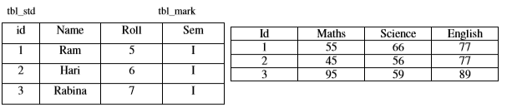
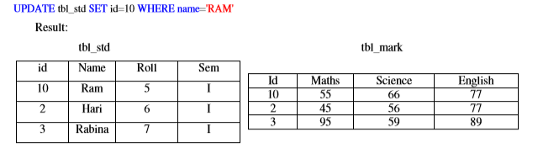
3. Change the id of Ram to 10

Slide 14
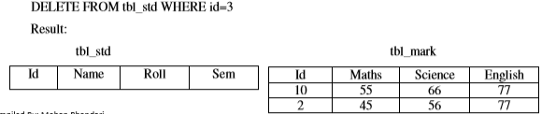

4. Delete the record of student whose id is 3

Slide 15
Assertions
An assertion is a predicate expressing a condition that we wish the database always to satisfy.
An assertion in SQL takes the form create assertion <assertion-name> check <predicate condition>
When an assertion is made, the system tests it for validity, and tests it again on every update that may violate the assertion
This testing may introduce a significant amount of overhead; hence assertions should be used with great care.
The assertion is said to be violated if the query result is not empty and hence the user is denied from modifying the database.

Slide 16
Assertion Example
An expression that should be always true
DBMS checks the assertion after any change that may violate the expression
The sum of all loan amounts for each branch must be less than the sum of all account balances at the branch.
create assertion sum-constraint check (not exists (select * from branch where (select sum(amount) from loan where
loan.branch_name =branch.branch_name) >= (select sum(amount) from account where account.branch_name = branch.branch_name)))

Slide 17
In Sells(rest, soda, price), no rest may charge an average of more than $3.
create assertion NoRipoffs check ( not exists ( Select rest from Sells group by rest having avg(price) > 3 ));

Slide 18
Timing of Assertion Checks
Logically, assertions always are true
So when do we have to check them?
Logically, after any change
Practically, the DBMS could calculate the set of important changes

Slide 19
Triggers
All the power of assertions but easier to implement:
A Trigger is a special kind of stored procedure that the system executes automatically as a side effect of a modification to the database.
Most of the time while performing data manipulation on a database object, we might also need to perform manipulation on another object.
To perform such operation, DBMS allow us to implement triggers.
A trigger is a set of T-SQL statement activated in response to certain action, such as insert or delete.
Triggers are used to ensure data integrity before and after performing data manipulation.

Slide 20
When to use Trigger?
If you own an organization and your employees use online leave approval system to apply for leaves.
Now when any employees apply for a leave, the leave details are stored in LEAVE_DETAIL table. In addition a new record is automatically added to the LEAVES_APPROVAL table so that the supervisor sees it sometime later.
So for performing such automated task in database, triggers are used.

Slide 21
Steps to design trigger
1. Specify when trigger to be executed
2. Specify the action to be taken when the trigger executes.
Three parts of trigger
1. Event like insert, update or delete which activates a trigger.
2. Condition, which test if trigger should run or not.
3. Action, task that run if trigger is activated.

Slide 22
Types of Trigger
1. DML Trigger:
A DML trigger is fired when data in the underlying table is affected by DML statements such as insert, update, or delete. These trigger help in maintaining consistent, reliable and correct data in tales.
Types:
a) Insert trigger: is fired whenever an attempt is made to insert a row in the trigger.
b) Delete trigger: is fired whenever an attempt is made to delete a row in the trigger.
c) Update trigger: is fired whenever an update statement is executed in the trigger table.
2. DDL Trigger:
A DDL trigger is fired in response to DDL statement, such as create, alter table etc. DDL trigger can be
used to perform administrative tasks. E.g. A database administrator can be notified whenever a table is
created in master database by creating a DDL trigger.

Slide 23
EXAMPLE
a) Create an insert trigger to display all the record of PRODUCT relation.
create trigger trg_display on PRODUCT for INSERT AS
BEGIN
SELECT * FROM PRODUCT
END
Under execution of above statement, a trigger named trg-display is created for table PRODUCT.
insert into tbl_ram values (6,'ram',3,4,5,5)

Slide 24
Now if the above INSERT query is executed on trigger table PRODUCT, the insert trigger automatically fired to show the entire records on table PRODUCT.
b) Delete the above trigger.
Drop trigger trg_display

Slide 25
Assertions vs. Triggers
Assertions do not modify the data, they only check certain conditions where as Triggers are more powerful because the can check conditions and also modify the data
Assertions are not linked to specific tables in the database and not linked to specific events where as Triggers are linked to specific tables and specific events
All assertions can be implemented as triggers (one or more) whereas Not all triggers can be implemented as assertions
Oracle does not have assertions but has triggers

Slide 26
Functional Dependencies
The normalization theory is based on the fundamental notation of functional dependency.
Give a relation R, attribute B is said to be functionally dependent on attribute A if each value of B in R is associated with precisely one value of A.
In other word, attribute B is functionally dependent on A if and only if, for each value of B there is exactly one value of A.
So it is also called, A determine B or B is function of A.
A functional dependency is denoted by A ->B and read as ‘A determine B’.
A is called the determinant and B is the object of determinant.

Slide 27
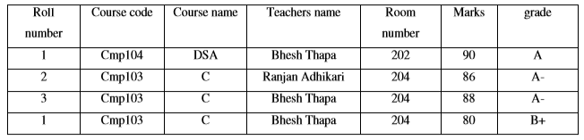
If more than one attribute is necessary to determine another attribute, then such determinant is called as compound Determinant
Example: Let us consider the following relation.

Slide 28
The preceding table has composite key (Roll number + Course code).
In the preceding table, for a particular value of Roll number, Course code there is precisely one corresponding value for Marks.
Hence Marks is functionally dependent on these two attributes.
This can be symbolically represented as (Roll number, Course code)->Marks
The other functional dependencies in the preceding table are:
1. Course code -> Course name
2. Course code -> Room no
3. Marks -> Grade
4. Roll no -> Teacher name

Slide 29
Characteristics of Functional Dependencies
Main characteristics of functional dependencies used in normalization:
There is a one-to-one relationship between the attribute(s) on the left hand side (determinant) and those on the right-hand side of a functional dependency.
Holds for all time.
The determinant has the minimal number of attributes necessary to maintain the dependency with the attribute(s) on the right hand-side.

Slide 30
Trivial and Non-Trivial Functional Dependency
A functional dependency is trivial, if the consequent is a subset of the determinant i.e. a functional dependency of the form
α ->β is trivial if β is subset of α
Example:
A-> A
AB -> A
Course code, Course name -> Course code
Course code, Course name -> Course name
Course code -> Course code
So from above examples we see that, it is impossible for trivial dependency not to be satisfied.

Slide 31
A functional dependency is non-trivial, if dependency is not trivial i.e. the consequent is not a subset of the determinant.
Example:
A -> B
Teacher name -> Room number
Roll number, Course code -> Marks

Slide 32
Partial and Full Functional Dependency
A partial dependency is dependency in which a non-key attribute is dependent on only a part of composite key.
This is the situation in which only a subset of the attributes of the composite key is used to uniquely identify its object.
A full functional dependency is dependency in which a non-key attributes is dependent on all the attributes of composite key.
This is the situation in which all the attributes of the composite key is used to uniquely identify its object.

Slide 33
Example:
The attribute Course name is not fully functionally dependent on composite key (Roll number + Course code).
It is only dependent on subset of composite key i.e. Course code. Similarly, Room number are only dependent on Course code and Teacher name is only dependent on Roll number
So Course name, Teacher name, Room number attributes are said to have partial dependencies on the whole key.
Again, the attribute Mark and Grade are dependent on all the attributes of composite key (Roll number +Course code).
So the attributes Mark and Grade are said to have full functional dependencies on the whole key.

Slide 34
Transitive (Indirect) Dependency
A functional dependency of the form X -> Z is said to be Transitive if both X -> Y and Y -> Z holds.
Example
In the preceding table, Room number is dependent on Teacher name and Teacher name is dependent on Course code.
Therefore Room number is dependent on Course code. This type of dependency is called transitive dependency.
It is shown as below
Course code -> Teacher name and Teacher name -> Room number means Course code -> Room number

Slide 35
Multi-valued Dependency (MVD):
MVD occurs if two or more independent multi-valued facts about the same attribute occur within the same relation.
MVD X→→ Y read as “ X multi-determines Y” defines a relationship in which a set of attributes Y are determined by a single value of X.
An MVD X →→ Y is said to hold over Relation R if, for each instance r of R, X value is associated with a set of Y values and this set is independent of the values in the other attribute.
An MVD X→→Y over Relation R is said to be trivial MVD if y is subset of x or X and Y together form the relation R i.e. X U Y=R otherwise it is said to be non-trivial MVD.
It represent a dependency between attributes(for example A, B and C) in a relation, such that for each value of A there is a set of values for B and a set of values for C. however, the set of values for B and C are independent of each other.

Slide 36
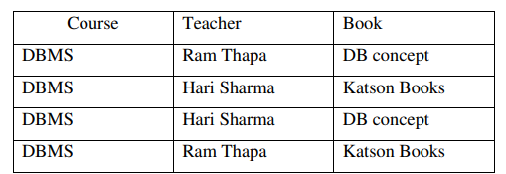
Consider the following relation with MVD.
Here Course→→Teacher and Course →→Book

Slide 37
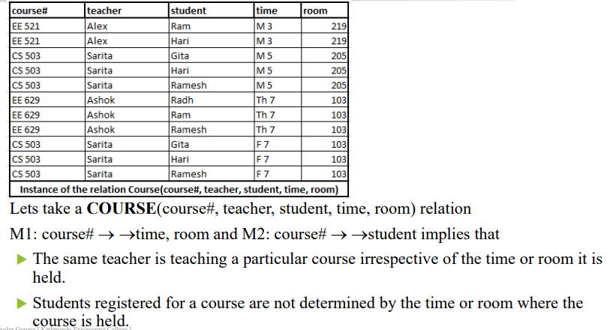

Slide 38
Normalization
Normalization is the process of breaking down complex table structures into simple table structure by using certain rules.
Using this method, we can reduce redundancy in a table, and eliminate the problems of inconsistency and disk space usage.
Also we can ensure that there is no loss of information.
Normalization is the process of efficiently organizing data in database with two goal:
Eliminate redundant data
Ensure data dependencies make sense
Data normalization also may improve data consistency and simplify future extension of the logical data model.

Slide 39
The formal classifications used for describing a relational database's level of normalization are called normal forms
Normal Forms is abbreviated as NF

Slide 40
What happen without Normalization
A non-normalized database can suffer from data anomalies:
A non-normalized database may store data representing a particular referent in multiple locations.
An update to such data in some but not all of those locations results in an update anomaly, yielding inconsistent data.
A non-normalized database may have inappropriate dependencies, i.e. relationships between data with no functional dependencies.
Adding data to such a database may require first adding the unrelated dependency.

Slide 41
A normalized database prevents such an anomaly by storing such data (i.e. data other than primary keys) in only one location.
A normalized database prevents such insertion anomalies by ensuring that database relations mirror functional dependencies.
Similarly, such dependencies in non-normalized databases can hinder deletion. That is, deleting data from such databases may require deleting data from the inappropriate dependency.
A normalized database prevents such deletion anomalies by ensuring that all records are uniquely identifiable and contain no extraneous information.

Slide 42
Advantages of Normalization
It helps in maintaining data integrity.
It helps in simplifying the structure of table.
Easier to add data.
It is flexible model for structuring of data.
It eliminates redundant data.
Less storage space.
Better Understanding of data because each table stores data for a single type of entity.

Slide 43
Normalized database
Normalized databases have a design that reflects the true dependencies between tracked quantities, allowing quick updates to data with little risk of introducing inconsistencies.
Instead of attempting to lump all information into one table, data is spread out logically into many tables.
Normalizing the data is decomposing a single relation into a set of smaller relations which satisfy the constraints of the original relation.
Redundancy can be solved by decomposing the tables. However certain new problems are caused by decomposition.
Normalization helps us to make a conscious decision to avoid redundancy keeping the pros and cons in mind.

Slide 44
One can only describe a database as having a normal form if the relationships between quantities have been rigorously defined.
The transformation of conceptual model to computer representation format is known as Normalization.

Slide 45
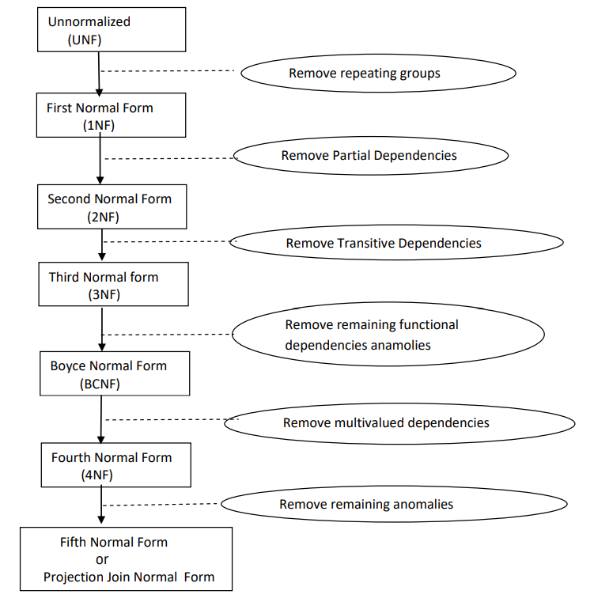
Stages of Normalization

Slide 46
1. Un-Normalized Normal Form (UNF)
A relation is Un-normalized if no any normalization r rules has been applied to it.
An un-normalized relation suffers from various anomalies.
Any un-normalized relation has repeating groups, i.e. it has more than one value or list of values for a cell. Hence Cell is not single-valued.
Data redundancy is another main problem for such relation.
Consider the following PROJECT relation.

Slide 47
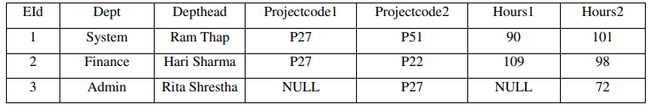
The above PROJECT relation is un-normalized because there are repeating groups .ie two Projectcode fields and two Hours field.
In this table, to add a third Projectcode, we have to add new projectcode3 field. So this is not an efficient way of designing a database.

Slide 48
First Normal Form (1NF)
First normal form (1NF) lays the groundwork for an organized database design
A relation is said to be in 1NF if and only if
There are no duplicate rows in the table .
Each cell is single valued i.e. there are no repeating groups or arrays.
Data for a particular column are of similar kind.
Ensure that each table has a primary key: minimal set of attributes which can uniquely identify a record.
Eliminate repeating groups (categories of data which would seem to be required a different number of times on different records) by defining keyed and non-keyed attributes appropriately.
Atomicity: Each attribute must contain a single value, not a set of values.
The above PROJECT table already satisfies two conditions to be in 1NF i.e. Data for each attributes are of same kind and there are no duplicate rows in the table. However it is not in 1NF because it has two repeating groups i.e. Projectcode and Hours. So by applying the 1NF rules, we arrive at the following table.

Slide 49
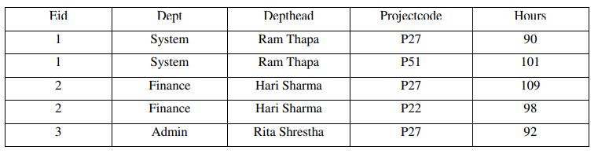

Slide 50
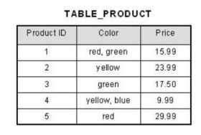
Example 1:
1. Convert the following un-normalized relation to 1NF

Slide 51
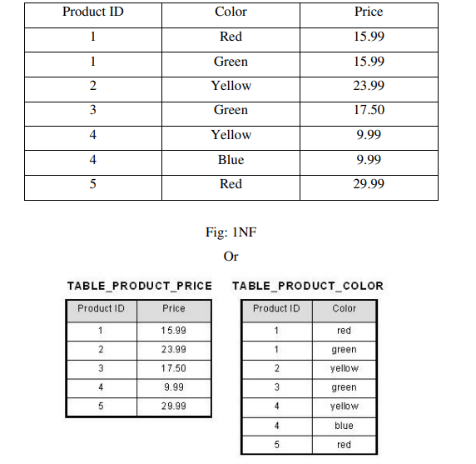

Slide 52
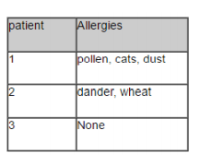
Example 2:

Slide 53
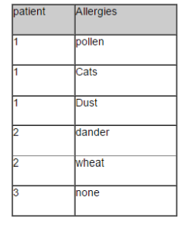

Slide 54
3. Second Normal Form (2NF):
A relation is in 2NF if and only if –
It is in 1NF.
No partial dependencies exists between non key attributes and key attributes.
The main aim of second normal form is to ensure that all information in one relation is only about one thing.
We should also maintain relationship between these new table and their predecessors through the use of foreign key.
In the preceding table, the primary key is composite (Eid + Projectcode) and there are no repeating groups so it satisfies the definition of 1NF.
Also the non key attribute Hours is fully functionally dependent on whole key.
However the above table in not in 2NF because the non key attributes Dept and Depthead are functionally dependent on part of Composite key i.e. EiD but not Project code.

Slide 55
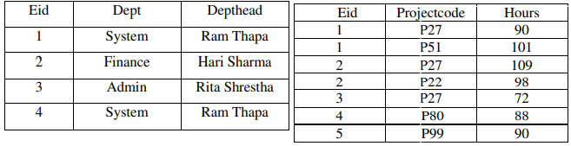
So by applying the rules of 2NF, i.e. removing the partial dependencies by placing the removed attributes in a different table along with the attribute (determinant) they are functionally dependent on, we arrive at the following two tables.

Slide 56
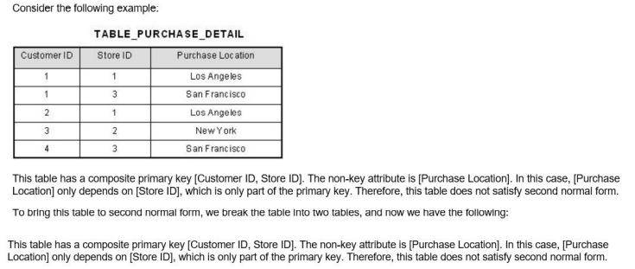

Slide 57
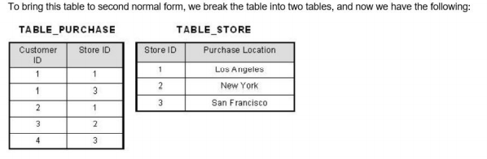

Slide 58
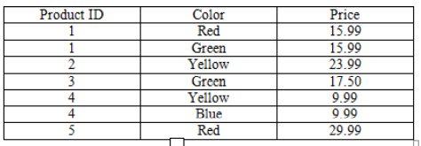

Slide 59
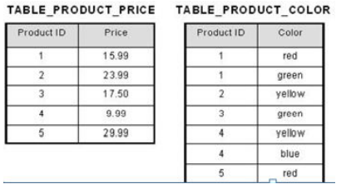

Slide 60
Example 3
Order(order_no, order_date, item_code, quantity, price)
Given functional dependecnies fd1= order_no→order_date
Fd2= order_no, item_code→quantity
Fd3= item_code→price
Here composite key is (order_no + item_code) and we see partial dependencies so converting to 2NF we get
Tbl1(order_no,order_ate)
Tbl2(item_code, price)
Tbl3(order_no,item_code,quantity)

Slide 61
4. Third Normal Form (3NF):
A relation is said to be in 3NF if and only if –
It is in 2NF.
No transitive dependencies exists between non-key attributes and the key attributes i.e. no non key attribute functionally dependent on other non-key attributes. i.e ( If transitive dependencies exist on the primary key remove them bye placing them in a new relation along with a copy of their dominant. )
In the preceding tables, both of them are in 2NF because hours is fully functionally dependent on whole key (id + project code), Dept and Depthead are also functional y dependent on Eid.
However it is not in 3NF because, the non key attribute Depthead is dependent on the non key attribute Dept, resulting transitive dependencies.
So by applying the rules of 3NF, i.e. removing the non key attribute Depthead which is dependent on non-key attribute Dept, by placing the removed attribute in different table with the attribute it is functionally dependent on , we arrive at the following three tables.

Slide 62
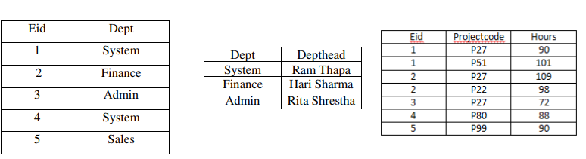

Slide 63
5. Boyce-Codd Normal Form (BCNF)
BCNF is an extended form of 3NF.
The original definition of 3NF is not sufficient in -for the table: -
That has multiple candidate keys.
Where the multiple candidate keys were composite.
Where the multiple candidate keys overlapped i.e. some attribute in the keys are common.
Therefore a new normal form named BCNF was introduced. In tables, where the preceding two conditions do not apply, we can stop at third normal form.
In such case 3NF is same as the BCNF.
A relation is in BCNF is and only if –
It is in 3NF. –
if every determinant is a candidate key.

Slide 64
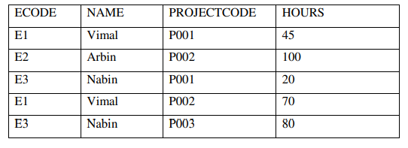
Example
Consider the following PROJECT table.
In the preceding table, ECODE + PROJECTCODE is the primary key, however NAME + PROJECTCODE could be choose as the primary key hence is a candidate key.
It is in 3NF because, HOURS is Functional dependent on ECODE + PROJECTCODE and NAME + PROJECTCODE i.e. no partial and transitive dependencies exist here.

Slide 65
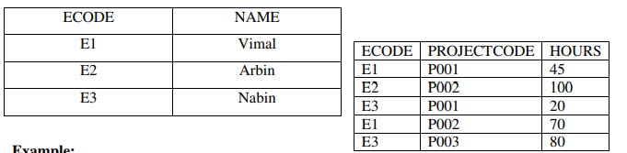
Also we see that, Name is functional dependent on ECODE and ECODE is functional dependent on NAME, Multiple candidate keys, Composite candidate key, and overlapped candidate key i.e. PROJECTCODE is common between the two candidate key.
So this situation requires conversion to BCNF. As per the rule of BCNF, every determinant must be candidate key but here ECODE and NAME are determinant but are not candidate key by themselves.
Hence using BCNF , make the determinant to be candidate keys, i.e. removing NAME and ECODE and place them in different table, we arrive at following two tables.

Slide 66
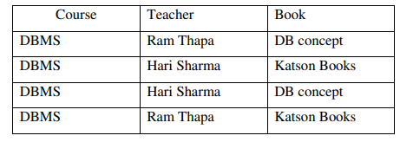
6. Fourth Normal Form (4NF):
A table is in 4NF is and only if
if it is in BCNF.
it contains no multivalued dependencies.
The redundancy caused by MVDs can’t be removed by transforming the database schema to BCNF.
So there is a stronger normal form called 4NF that treats MVDs as FDs when it comes to decomposition. If a relation is in 4NF then it is also in BCNF.
Let us consider the following relation.

Slide 67
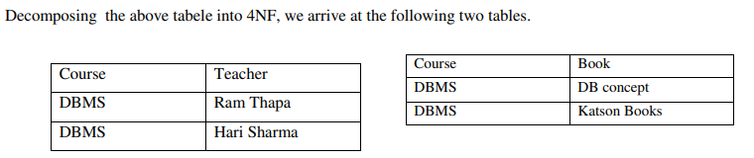
Decomposing the above tabele into 4NF, we arrive at the following two tables.
So in 4NF, if we have more than one multi-valued attribute then, we should decompose it to have relations that has information about only one entity so as to remove the difficulties with multi-valued fact.

Slide 68
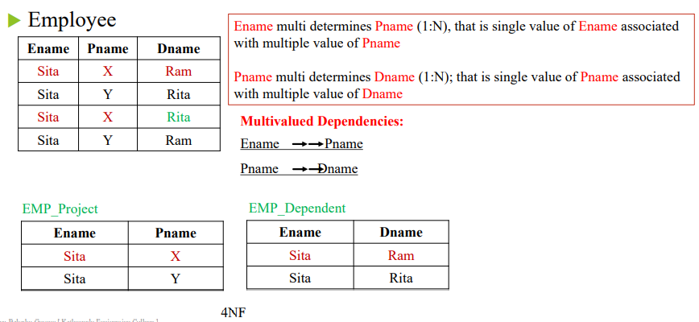

Slide 69
Decomposition of Relation Schema
If a relation R is not in any normal form and we wish the relation to be normalized to remove several anomalies then it is necessary to decompose the relation into two or more relations set R1, R2,R3……….RN.
The decomposed relations R1, R2, R3……….RN. are projections of R and are not disjointing otherwise the glue holding the information together would be lost.
Hence, Careless decomposition leads to another problem of bad design.
Properties of decomposition
Attribute preservation
Lack of redundancy
Lossless join decomposition.
Dependency Preservation

Slide 70
a. Attribute Preservation:
All the attributes that were in the original relation which is being decomposed, must be preserved in the resulting decomposed relations set.
b. Lack of Redundancy:
Redundancy is the problem of repetition of data in the database.
Such problem should be avoided as much as possible.
c. Lossless Join Decomposition:
A decomposition of a relation R into relations R1, R2, R3…………RN is called lossless / on-loss decomposition if the relation R is always the natural join of relations R1, R2, R3…………RN.
It should be noted that natural join is the way to recover the relation form the decomposed relations.

Slide 71
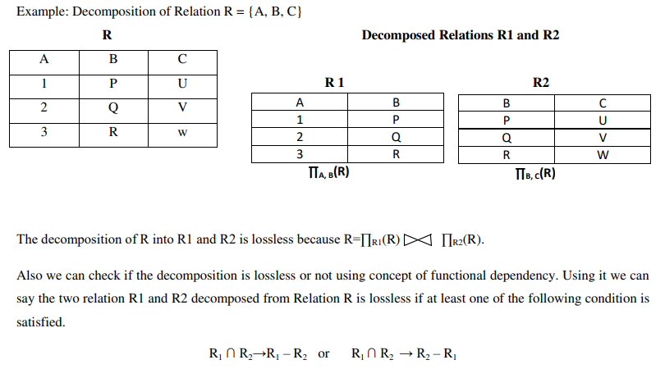

Slide 72
d. Dependency Preservation:
A decomposition D={R1, R2, R3………RN} of R is dependency preserving with respect to F if the union of the projections of F on each Ri in D is equivalent to F i.e. (F1 U F2 U ……FN) + = F+
Example: Given R(A, B, C) and F={A → B, B → C}
The above relation R can be decomposed in two different ways.
1. R1 ={A,B} and R2 = {B, C} Here F1 ={A → B } and F2 ={B → C}
Here (F1 U F2) + = F+ , Therefore the decomposition is dependency preserving.
2 . R1 ={A,B} and R2 = {A, C} Here F1 ={A → B } and F2 ={A → C}
Here (F1 U F2) + ≠ F+ , Therefore the decomposition is not dependency preserving.
Notes:
The closure of F, denoted as F+, is the set of all regular FDs that can be derived from F.

Slide 73
Join Dependency (JD) and Fifth Normal Form (5NF)
A Relation R is subject to a join dependency denoted by JD if R can always be recreated by joining multiple tables each having a subset of the attributes of R.
If one of the Relations in the join has all the attributes of the Relation Rs, the join dependency is called trivial join dependency.
Let R be a relation schema and R1, R2………..RN are projection of R. a legal relation r(R) satisfies the join dependency (JD) if and only if join of projection of relation on Ri [i=1, 2, 3……..N] is equal to

Slide 74
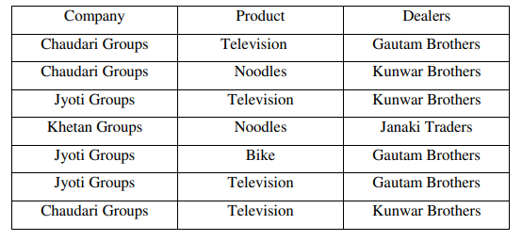
Fifth normal form is based on the join dependency.
A relation R is in fifth normal form or project join normal form (PJNF) if and only if every non trivial join dependency is implied by the super keys of R.
Also, if the relation is in 4NF and every join dependency in it is implied by the candidate key then, we can say that the relation is in 5NF.
Let us consider the following relation PRODUCT.

Slide 75
